Slide 1
Topik 2 Konsep dan Arsitektur Sistem Basis Data
Ir. Endang Ripmiatin, MT
Program Studi Teknik Informatika
Universitas Al Azhar Indonesia
September 2017

Slide 2
Topik Bahasan
Model data, skema, dan instans
Tiga-skema Arsitektur dan Data Independence
Bahasa dan Antar Muka Basis Data
Lingkungan Sistem Basis Data
Arsitektur Centralized dan Client/Server
Arsitektur dasar client/server DBMS
Client module
Server module
Klasifikasi Sistem Manajemen Basis Data

Slide 3
Model data, skema, dan instans₁
Model data, skema, dan instans
Abstraksi Data
Definisi abstraksi data dari Bab 1
Menyembunyikan detail organisasi dan penyimpanan data
→ Merupakan fitur penting untuk memperbaiki pemahaman data
Karakteristik mendasar dalam basis data → menyediakan tingkat abstraksi dengan menyembunyikan detail penyimpanan data
Notes:
One fundamental characteristic of the database approach is that it provides some level of data abstraction by hiding details of data storage that are not needed by most database users. A data model-a collection of concepts that can be used to describe the structure of a database-provides the necessary means to achieve this abstraction. By structure of a database, we mean the data types, relationships, and constraints that should hold for the data. Most data models also include a set of basic operations for specifying retrievals and updates on the database.

Slide 4
Model data, skema, dan instans2
Model data, skema, dan instans
Model Data
Kumpulan konsep yang menjelaskan struktur basis data
Menyediakan metode untuk mencapai abstraksi data
Model data dilengkapi operasi dasar dan aspek dinamik atau perilaku dari aplikasi basis data
Menentukan penemuan-kembali (retrievals) dan pemutakhiran (updates) pada basis data → contoh: insert, delete, modify, retrieve
Memungkinkan perancang basis data untuk menentukan operasi user-defined yang valid terhadap objek basis data → contoh: compute_GPA
Notes:
A data model-a collection of concepts that can be used to describe the structure of a database-provides the necessary means to achieve this abstraction. By structure of a database, we mean the data types, relationships, and constraints that should hold for the data. Most data models also include a set of basic operations for specifying retrievals and updates on the database.
In addition to the basic operations provided by the data model, it is becoming more common to include concepts in the data model to specify the dynamic aspect or behavior of a database application. This allows the database designer to specify a set of valid user defined operations that are allowed on the database objects.:' An example of a user-defined operation could be COMPUTE_GPA, which can be applied to a STUDENT object. On the other hand, generic operations to insert, delete, modify, or retrieve any kind of object are often included in the basic data model operations. Concepts to specify behavior are fundamental to object oriented data models (see Chapters 20 and 21) but are also being incorporated in more traditional data models. For example, object-relational models (see Chapter 22) extend the traditional relational model to include such concepts, among others.

Slide 5
Kategori Model Data₁
Model data, skema, dan instans
Model data high-level atau konseptual
Menggambarkan bagaimana pengguna memahami data → untuk pengguna awam
Model data low-level atau fisikal
Menjelaskan detil bagaimana data disimpan dalam media penyimpanan → untuk computer specialist
Diantara high level dan low level terdapat class of representational (Representasi model data):
Harus mudah dipahami pengguna
Harus sama dengan pengorganisasian dalam penyimpanan komputer
Notes:
Many data models have been proposed, which we can categorize according to the types of concepts they use to describe the database structure.
High-level or conceptual data models provide concepts that are close to the way many users perceive data, whereas low-level or physical data models provide concepts that describe the details of how data is stored in the computer. Concepts provided by low-level data models are generally meant for computer specialists, not for typical end users.
Between these two extremes is a class of representational (or implementation) data models, which provide concepts that may be understood by end users but that are not too far removed from the way data is organized within the computer. Representational data models hide some details of data storage but can be implemented on a computer system in a direct way.

Slide 6
Kategori Model Data₂
Model data, skema, dan instans
Data model konseptual menggunakan konsep:
Entiti
Merepresentasikan objek atau konsep dalam dunia nyata
Atribut
Merepresentasikan properti dari suatu objek
Menjelaskan lebih jauh suatu entiti
Relasi antara dua atau lebih entiti
Merepresentasikan asosiasi antar entiti
Entity-Relationship model → model E-R
Notes:
Conceptual data models use concepts such as entities, attributes, and relationships.
An entity represents a real-world object or concept, such as an employee or a project, that is described in the database.
An attribute represents some property of interest that further describes an entity, such as the employee's name or salary.
A relationship among two or more entities represents an association among two or more entities, for example, a works-on relationship between an employee and a project.

Slide 7
Kategori Model Data₃
Model data, skema, dan instans
Model data relasional
Lebih banyak digunakan dalam DBMS komersial yang tradisional
Seringkali disebut record based data model.
Model data objek
Keluarga baru dalam implementasi model data higher-level
Lebih dekat pada model data konseptual
Notes:
Representational or implementation data models are the models used most frequently in traditional commercial DBMSs. These include the widely used relational data model, as well as the so-called legacy data models-the network and hierarchical models-that have been widely used in the past.
Representational data models represent data by using record structures and hence are sometimes called record-based data models. We can regard object data models as a new family of higher-level implementation data models that are closer to conceptual data models.
Object data models are also frequently utilized as high-level conceptual models, particularly in the software engineering domain.

Slide 8
Kategori Model Data₄
Model data, skema, dan instans
Model data fisikal
Menjelaskan bagaimana data disimpan sebagai berkas dalam komputer
Contoh: record formats, record orderings, dan access paths.
Access path
Struktur khusus yang memungkinkan pencarian suatu rekor dalam basis data secara efisien
Index
Merupakan salah satu contoh access path
Memungkinkan akses langsung ke data menggunakan indeks atau kata kunci
Notes:
Physical data models describe how data is stored as files in the computer by representing information such as record formats, record orderings, and access paths. An access path is a structure that makes the search for particular database records efficient.

Slide 9
Skema, instans dan basis data snapshot₁
Model data, skema, dan instans
Skema basis data
Deskripsi basis data
Ditentukan saat perancangan basis data, dan diharapkan tidak sering berubah.
Umumnya menggunakan diagram dengan konvensi tertentu.
Diagram skema
Menampilkan aspek tertentu dari skema
Notes:
In any data model, it is important to distinguish between the description of the database and the database itself. The description of a database is called the database schema, which is specified during database design and is not expected to change frequently. Most data models have certain conventions for displaying schemas as diagrams.
A displayed schema is called a schema diagram. A schema diagram displays only some aspects of a schema, such as the names of record
types and data items, and some types of constraints. Other aspects are not specified in the schema diagram; for example, Figure 2.1 shows neither the data type of each data item nor the relationships among the various files. Many types of constraints are not represented in
schema diagrams. A constraint such as "students majoring in computer science must take CS1310 before the end of their sophomore year" is quite difficult to represent.

Slide 10
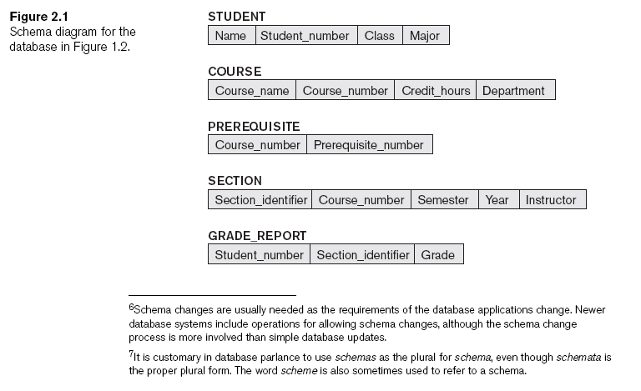
Skema, instans dan basis data snapshot ₂
Model data, skema, dan instans
Setiap objek dalam skema – contoh: STUDENT or COURSE – disebut schema construct.
Notes:
Figure 2.1 shows a schema diagram for the database shown in Figure 1.2; the diagram displays the structure of each record type but not the actual instances of records. We call each object in the schema-such as STUDENT or COURSE-a schema construct.

Slide 11
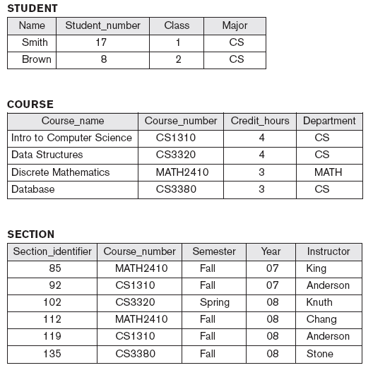
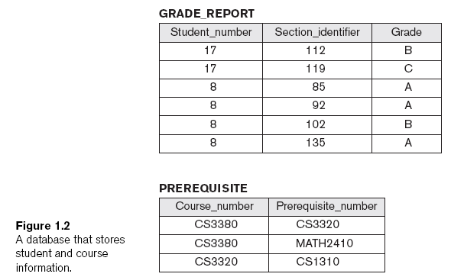
Contoh tabel penyimpanan data
Konsep Dasar DBMS
Dari Bab 1

Slide 12
Skema, instans dan basis data snapshot₃
Model data, skema, dan instans
Data aktual dalam basis data seringkali berubah.
Database state atau snapshot
Data dalam basis data pada suatu waktu tertentu → disebut instance
Setiap kali terjadi insert atau delete data berarti kita mengubah database state yang satu ke database state yang lain.
Notes:
The actual data in a database may change quite frequently. For example, the database shown in Figure 1.2 changes every time we add a student or enter a new grade for a student. The data in the database at a particular moment in time is called a database state or snapshot. It is also called the current set of occurrences or instances in the database. In a given database state, each schema construct has its own current set of instances; for example, the STUDENT construct will contain the set of individual student entities (records) as its instances. Many database states can be constructed to correspond to a particular database schema. Every time we insert or delete a record or change the value of a data item in a record, we change one state of the database into another state.

Slide 13
Skema, instans dan basis data snapshot₄
Model data, skema, dan instans
Perbedaan antara database schema dan database state sangatlah penting:
Mendefinisikan basis data baru
Menentukan skema basis data dalam DBMS
Database state = kosong
Kondisi awal (initial state)
Mengisi basis data dengan data awal
Kondisi valid
Memenuhi struktur dan batasan yang ditentukan dalam skema
Evolusi skema
Perubahan skema sesuai perubahan kebutuhan aplikasi
Notes:
The distinction between database schema and database state is very important.
When we define a new database, we specify its database schema only to the DBMS. At this point, the corresponding database state is the empty state with no data. We get the initial state of the database when the database is first populated or loaded with the initial data.
From then on, every time an update operation is applied to the database, we get another database state. At any point in time, the database has a current state. The DBMS is partly responsible for ensuring that every state of the database is a valid state--that is, a state that satisfies the structure and constraints specified in the schema. Hence, specifying a correct schema to the DBMS is extremely important, and the schema must be designed with the utmost care. The DBMS stores the descriptions of the schema constructs and constraints-also called the meta-data-in the DBMS catalog so that DBMS software can refer to the schema whenever it needs to.
Although, as mentioned earlier, the schema is not supposed to change frequently, it is not uncommon that changes need to be occasionally applied to the schema as the application requirements change. For example, we may decide that another data item needs to be stored for each record in a file, such as adding the DateOfBirth to the STUDENT schema in Figure 2.1. This is known as schema evolution. Most modern DBMSs include some operations for schema evolution that can be applied while the database is operational.

Slide 14
Tiga-skema Arsitektur₁
Tiga-skema Arsitektur dan Data Independence
Level Internal
Mendeskripsikan struktur penyimpanan basis data secara fisikal
Level Konseptual
Mendeskripsikan struktur dari keseluruhan basis data kepada komunitas pengguna
Level Eksternal atau level view
Mendeskripsikan bagian dari basis data yang dibutuhkan oleh sekelompok pengguna tertentu
Dari bab 1 diketahui bahwa terdapat 4 karakteristik penting dalam pendekatan basis data:
Self describing nature
Isolasi antara program dan data (program-data dan program-operation independence),
Mendukung multiple user views,
Menggunakan katalog untuk menyimpan deskripsi basis data (schema).
Notes:
The four important characteristics of the database approach, listed in Section 1 are (1) insulation of programs and data (program-data and program-operation independence), (2) support of multiple user views, (3) use of a catalog to store the database description (schema), and (4) self-describing nature.
In this section we specify an architecture for database systems, called the three-schema architecture. that was proposed to help achieve and visualize these characteristics. We then further discuss the concept of data independence.

Slide 15
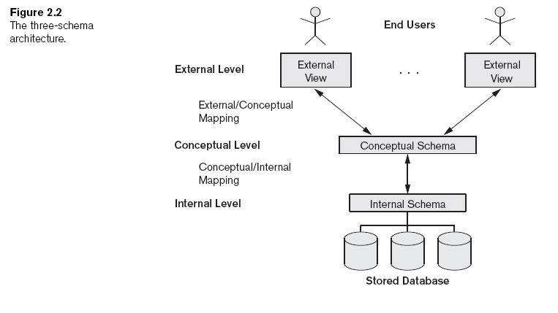
Tiga-skema Arsitektur ₂
Tiga-skema Arsitektur dan Data Independence
Notes:
The goal of the three-schema architecture, illustrated in Figure 2.2, is to separate the user application sand the physical database. In this architecture, schemas can be defined at the following three levels:
The internal level has an internal schema, which describes the physical storage structure of the database. The internal schema uses a physical data model and describes the complete details of data storage and access paths for the database.
The conceptual level has a conceptual schema, which describes the structure of the whole database for a community of users. The conceptual schema hides the details of physical storage structures and concentrates on describing entities, data types, relationships, user operations, and constraints. Usually, a representational data model is used to describe the conceptual schema when a database system is implemented. This implementation conceptual schema is often based on a conceptual schema design in a high-level data model.
The external or view level includes a number of external schemas or user views. Each external schema describes the part of the database that a particular user group is interested in and hides the rest of the database from that user group. As in the previous case, each external schema is typically implemented using a representational data model, possibly based on an external schema design in a high level data model.

Slide 16
Tiga-skema Arsitektur ₃
Tiga-skema Arsitektur dan Data Independence

Slide 17
Data Independence
Tiga-skema Arsitektur dan Data Independence
Ke-3 skema arsitektur dapat digunakan untuk menjelaskan konsep data independence
Data Independence dapat didefinisikan sbb:
Kapasitas untuk mengubah skema pada suatu level dalam sistem basis data
Tanpa harus melakukan perubahan skema pada level yang lebih tinggi
Jenis Data Independence :
Logikal → mengubah skema konseptual tanpa harus mengubah skema eksternal
Fisikal → mengubah skema internal tanpa harus mengubah skema konseptual
Notes:
1. Logical data independence is the capacity to change the conceptual schema without having to change external schemas or application programs. We may change the conceptual schema to expand the database (by adding a record type or data item), to change constraints, or to reduce the database (by removing a record type or data item). In the last case, external schemas that refer only to the remaining
data should not be affected. For example, the external schema of Figure l.4a should not be affected by changing the GRADE_REPORT file shown in Figure 1.2 into the one shown in Figure 1.5a. Only the view definition and the mappings need be changed in a DBMS that supports logical data independence. After the conceptual schema undergoes a logical reorganization, application programs that reference the external schema constructs must work as before. Changes to constraints can be applied to the conceptual schema without affecting the external schemas or application programs.
2. Physical data independence is the capacity to change the internal schema without having to change the conceptual schema. Hence, the external schemas need not be changed as well. Changes to the internal schema may be needed because some physical files had to be reorganized-for example, by creating additional access structures-to improve the performance of retrieval or update. If the same data as before remains in the database, we should not have to change the conceptual schema. For example, providing an access path to improve retrieval speed of SECTION records (Figure 1.2) by Semester and Year should not require a query such as "list all sections offered in fall 1998" to be changed, although the query would be executed more efficiently by the DBMS by utilizing the new access path.

Slide 18
Bahasa DBMS
Bahasa dan Antar Muka Basis Data
Data Definition Language (DDL)
Mendefinikasi skema internal dan eksternal
Storage Definition Language (SDL)
Menentukan skema internal
View Definition Language (VDL)
Menentukan views/mappings ke skema konseptual
Data Manipulation Language (DML)
Memungkinkan penemuan-kembali, penyisipan, penghapusan, modifikasi data

Slide 19
Data Manipulation Language (DML)
Bahasa dan Antar Muka Basis Data
High-level atau nonprocedural DML
Dapat digunakan langsung, untuk menentukan operasi basis data yang kompleks secara singkat
Low-level atau procedural DML
Harus digunakan sebagai bagian dari bahasa pemrograman yang general-purpose
Umumnya DBMS menggabungkan berbagai kapabilitas DDL, VDL, DML dan SDL dalam single high-level DML (contoh SQL relational database language).

Slide 20
Data Manipulation Language (DML)
SQL insert data:
INSERT INTO 't_mahasiswa' ('id', 'mhs_nim', 'mhs_nm', 'IDProgdi', 'IDMahasiswa', 'stat_akd') VALUES
(NULL, '0802506119', 'Fariz Budiman', 2, '000BD407', '2'),
(NULL, '0802506120', ‘Anisa Agustini', 2, '000BC129', '1'),
(NULL, '0102506031', 'Asyra Rizki', 2, '0012E555', '3');

Slide 21
Data Manipulation Language (DML)
SQL UPDATE data:
UPDATE t_mahasiswa
SET mhs_nm='Abdul', IDProgdi='4'
WHERE mhs_nim='0102506031';
SQL DELETE data:
DELETE FROM t_mahasiswa
WHERE mhs_nim='0102506031';

Slide 22
Data Definition Language (DDL)
SQL create table t_mahasiswa:
CREATE TABLE IF NOT EXISTS 't_mahasiswa' (
'id' int(10) unsigned NOT NULL AUTO_INCREMENT,
'mhs_nim' varchar(10) NOT NULL,
'mhs_nm' varchar(255) NOT NULL,
'IDProgdi' int(10) DEFAULT NULL,
'IDMahasiswa' varchar(50) DEFAULT NULL,
'stat_akd' varchar(2) DEFAULT NULL,
PRIMARY KEY ('id'),
KEY 'mhs_nim' ('mhs_nim')
) ENGINE=MyISAM DEFAULT CHARSET=latin1 AUTO_INCREMENT=5876 ;

Slide 23
Antar Muka DBMS
Bahasa dan Antar Muka Basis Data
Antar muka berbasis menu untuk Web clients atau browsing
Antar muka berbasis forms
Antar muka berbasis grafis
Natural language interfaces
Speech input and output
Antar muka untuk parametric users
Antar muka untuk DBA

Slide 24
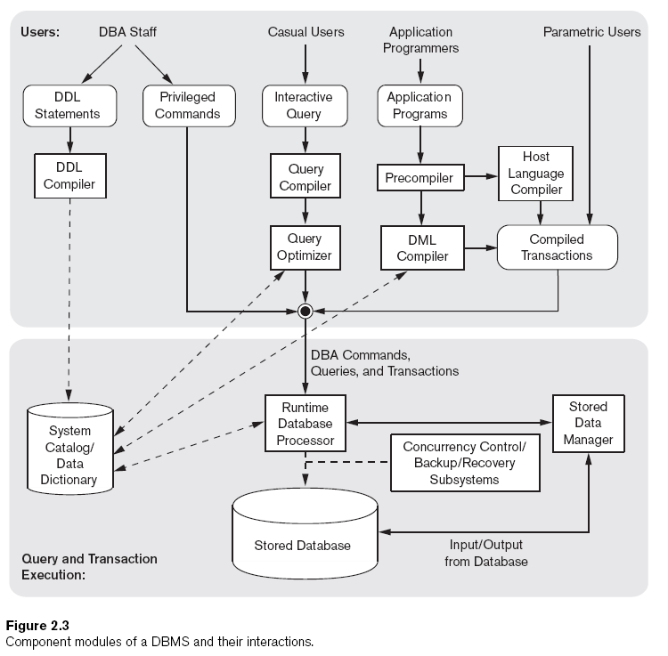
Lingkungan Sistem Basis Data

Slide 25
Utilitas Sistem Basis Data ₁
Lingkungan Sistem Basis Data
Loading
Mengisi berkas data
Backup
Membuat salinan basis data untuk backup

Slide 26
Utilitas Sistem Basis Data ₂
Lingkungan Sistem Basis Data
Database storage reorganization
Mengubah organisasi berkas basis data menjadi organisasi basis data yang berbeda
Performance monitoring
Memonitor penggunaan basis data dan menyediakan informasi statistik untuk DBA

Slide 27
Perangkat, Aplikasi dan Fasilitas Komunikasi
Lingkungan Sistem Basis Data
Perangkat CASE (Computer Aided Software Engineering)
Sistem Kamus Data (data repositori)
Menyimpan keputusan rancangan, standar penggunaan, deskripsi program aplikasi, dan informasi pengguna
Lingkungan pengembangan aplikasi
Perangkat lunak komunikasi

Slide 28
Arsitektur DBMS Centralized
Arsitektur Basis Data
Arsitektur Centralized
Semua fungsi DBMS, eksekusi progam aplikasi dan pemrosesan antar muka dilakukan dalam satu mesin.

Slide 29
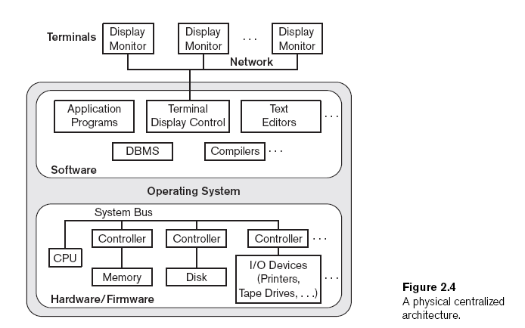
Arsitektur DBMS Centralized
Arsitektur Basis Data

Slide 30
Definisi Umum Client dan Server
Arsitektur Basis Data
Beberapa server dengan fungsi khusus
File server
Memelihara berkas dari mesin client.
Printer server
Terhubung pada berbagai printers; semua permintaan cetak yang diminta oleh clients diajukan ke mesin ini.
Web servers atau e-mail servers.
Mesin client
Menyediakan:
Antar muka untuk memanfaatkan server
Daya pemrosesan lokal untuk menjalankan aplikasi lokal
Notes:
We first discuss client/server architecture in general, then see how it is applied to DBMS.
The client/server architecture was developed to deal with computing environments in which a large number of PCs, workstations, file servers, printers, database servers, Web servers, and other equipment are connected via a network. The idea is to define specialized servers with specific functionalities. For example, it is possible to connect a number of PCs or small workstations as clients to a file server that maintains the files of the client machines. Another machine could be designated as a printer server by being connected to various printers; thereafter, all print requests by the clients are forwarded to this machine. Web servers or e-mail servers also fall into the specialized server category.
In this way, the resources provided by specialized servers can be accessed by many client machines. The client machines provide the user with the appropriate interfaces to utilize these servers, as well as with local processing power to run local applications. This concept can be carried over to software, with specialized software-such as a DBMS or a CAD (computer-aided design) package-being stored on specific server machines and being made accessible to multiple clients.

Slide 31
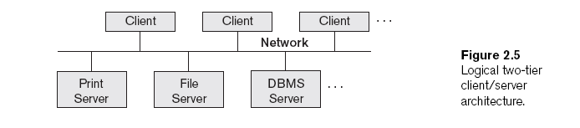
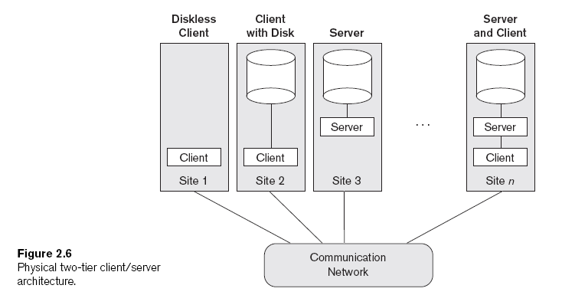
Arsitektur Dasar Client/Server ₁
Arsitektur Basis Data

Slide 32
Arsitektur Dasar Client/Server ₂
Arsitektur Basis Data
Client
Mesin pengguna yang menyediakan kapabilitas antar muka dan pemrosesan lokal.
Server
Sistem yang terdiri dari perangkat keras dan perangkat lunak.
Menyediakan layanan untuk mesin client
Seperti akses berkas, fasilitas cetak, fasilitas arsip, atau akses basis data

Slide 33
Arsitektur Two-Tier Client/Server ₁
Arsitektur Basis Data
Client handles
Program antar muka dan program aplikasi.
Server handles
Fungsi query dan dan transaksi yang berhubungan dengan pemrosesan SQL.

Slide 34
Arsitektur Two-Tier Client/Server ₂
Arsitektur Basis Data
Open Database Connectivity (ODBC)
Menyediakan Application Programming Interface (API).
Memungkinkan program di sisi-client untuk memanggil DBMS.
Perangkat lunak yang dibutuhkan, harus diinstal di mesin client dan server.
JDBC
Memungkinkan program Java client mengakses satu atau lebih DBMS melalui antar muka standar.

Slide 35
Arsitektur Three-Tier dan n-Tier untuk aplikasi Web ₁
Arsitektur Basis Data
Aplikasi server atau Web server
Menambahkan lapisan antara client dan server basis data
Menjalankan program aplikasi dan menyimpan aturan bisnis
N-tier
Membagi lapisan antara pengguna dan data menjadi komponen yang lebih kecil

Slide 36
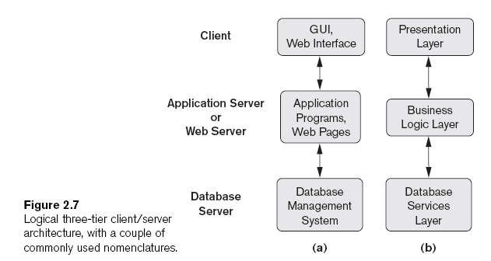
Arsitektur Three-Tier dan n-Tier untuk aplikasi Web ₂
Arsitektur Basis Data

